Slide 1


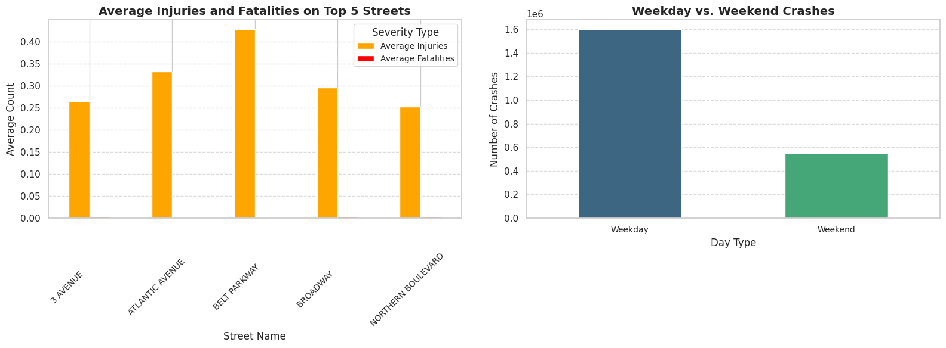
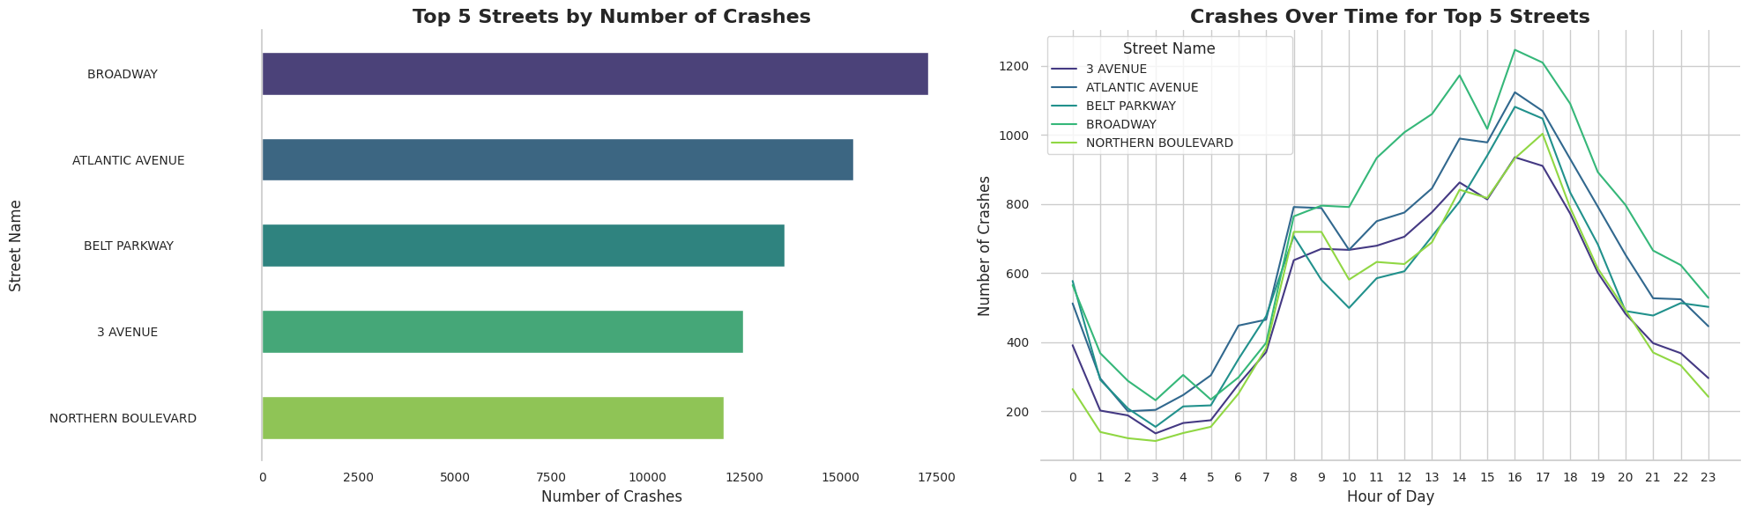
Crash Hotspots Analysis: Identifying Patterns and Preventing Accidents
Kai-Hsin Hung
Introduction
Department in Engineering | University of the Pacific
To address the growing concern of traffic safety, this is analysis focuses on identifying the streets with the highest crash rates, understanding the underlying factors contributing to these incidents, and exploring targeted prevention strategies. By analyzing crash patterns, severity levels, and time-based trends, the aim is to provide actionable insights to improve road safety and reduce the frequency and severity of accidents.
Broadway has the most crashes, while Belt Parkway records the highest injuries, indicating severe incidents. Crashes peak on weekdays due to heavy commuter traffic. Policies and awareness campaigns can enhance safety on high-risk streets and during peak hours.
Analysis
Accidents predominantly occur on Broadway Street, likely due to its complex layout, mixed traffic, and heavy tourism around areas like Times Square. Crashes for the top 5 streets peak around 3 PM, possibly driven by afternoon traffic congestion, a consistent pattern across these streets.
Figure 2: Injuries, Fatalities, and Crash Distribution by Day Type
Conclusion and Recommendations
Broadway leads in crash frequency, likely due to its layout and tourism, while Belt Parkway has the most severe crashes with the highest injuries. Crashes peak at 3 PM on weekdays, driven by rush-hour traffic.
Recommendations:
Redesign traffic flow and enforce speed controls on Broadway and Belt Parkway.
Launch awareness campaigns targeting drivers during weekday rush hours.
Improve pedestrian safety and road signage in tourist-heavy areas like Times Square.
Figure 1. Crash Frequency and Timing Across Streets
Acknowledgment
Special thanks to the Northeast Big Data Innovation Hub, National Student Data Corps, and the U.S. Department of Transportation for their collaboration and support in making this research possible.

